Slide 1
Tandem Diabetes Care Data Science Challenge
Sovik Kumar Nath

Slide 2
Contents
Key Takeaways
Business Problem 1
Data
Assumptions
Exploratory Analytics and Insights
Model, Results and Evaluation
Business Problem 2
Data
Assumptions
Exploratory Analytics and Insights
Model, Results and Evaluation
Next Steps and Improvements

Slide 3
Key Takeaways
There are cycles in glucose levels for daily range (24 hours)
Given presence of cycles, SARIMAX model produced decent results as glucose forecasting algorithm.
Problem 1
There is a pattern of average meal size with timing (hour of day); low in early part, goes up steadily in middle part of day, sharply falls at night, during 24 hours.
Given the nature, a polynomial curve of order 3 is appropriate for the distribution.
Problem 2

Slide 4
Business Problem 1
Business Problem 1
Glucose prediction algorithm that predicts glucose levels 30 minutes into the future
Data
Protocol H, “A Randomized Trial Comparing Continuous Glucose Monitoring With and Without Routine Blood Glucose Monitoring in Adults with Type 1 Diabetes”
Dataset : HDeviceCGM
Assumptions
Unique combination of subject is represented by : SiteID + RecordType + PtID + ParentHDeviceUploadsID
Reading record times are obtained from : DexInternalTm; Mapped at 5 mins interval
Device was active from number of days based on : DexInternalDtTmDaysFromEnroll
Glucose value is the variable to be predicted

Slide 5
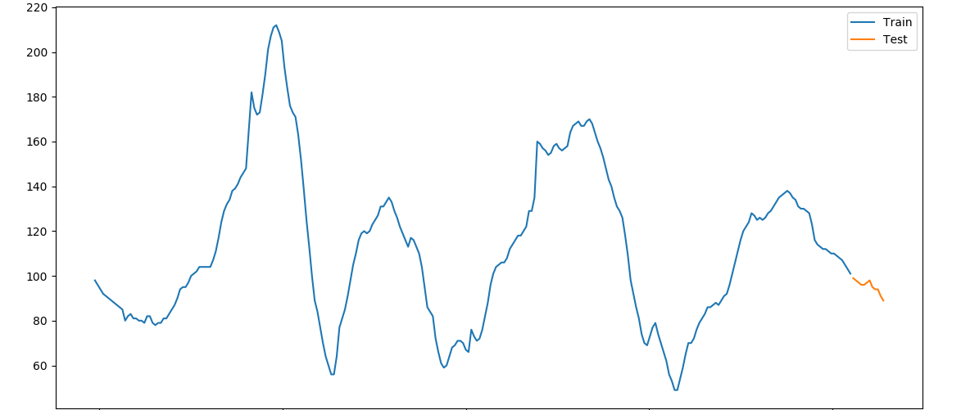
Business Problem 1
Exploratory Analytics and Insights
There are cycles in glucose levels for daily range (24hours)
Cycles in glucose levels for daily range (24hours)
Glucose Value
FUTURE
HISTORICAL
Time : 24 hours at 5 mins interval
Values for sample profile
SiteID : 12 RecordType : CGM PtID : 183
ParentHDeviceUploadsID : 782 DexInternalDtTmDaysFromEnroll - 86
PRESENT
FUTURE
Time Step : Training window
Forecasting
HISTORICAL

Slide 6
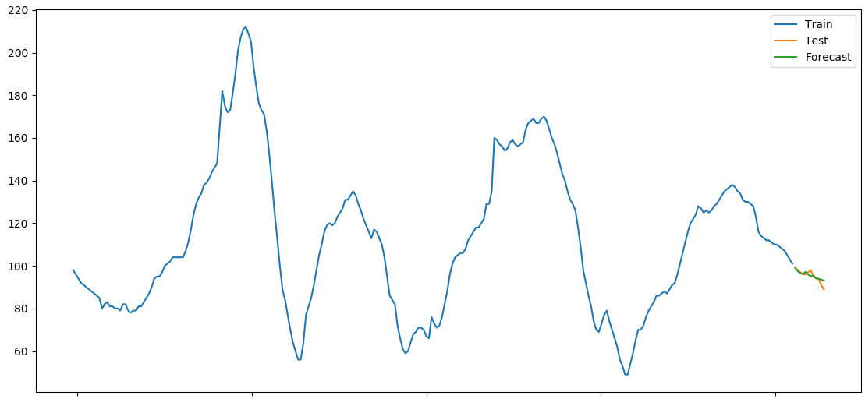
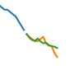
Business Problem 1
Model, Results and Evaluation
MODEL : SARIMAX (p,d,q,s) on sample time series
Forecasted to 60 mins to future
Glucose Value
In the initial state (first 60 mins) forecasted value is similar to actual/test values
Time : 24 hours at 5 mins interval
Model Evaluation Metrics
R2 : 0.64
MAPE : 2.81
RMSE : 1.7
SARIMAX Model for predicting glucose value for 60 mins has a high MAPE, overall a decent model

Slide 7
Business Problem 2
Business Problem 2
Analyze meal timing and size, fit distributions to this data, and use the distributions to create simulated meal data for newly created “virtual subjects”
Data
Protocol H, “A Randomized Trial Comparing Continuous Glucose Monitoring With and Without Routine Blood Glucose Monitoring in Adults with Type 1 Diabetes”
Dataset : HDeviceWizard
Assumptions
Unique combination of subject is represented by : SiteID + PtId + ParentHDeviceUploadsID
Reading record times are obtained from : DeviceTmHours; Mapped at 15 mins interval
Meal size is obtained from: CarbInput

Slide 8
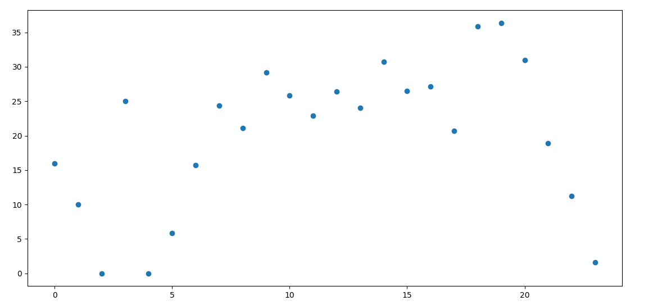
Business Problem 2
Exploratory Analytics and Insights
There is a visible pattern of average Carb Input (meal size) with timing (hour of day). It is low in the early part of day, goes up steadily during middle part and then sharply falls at late night, during 24 hours.
Average Meal size : Carb Input
Goes up steadily
Low
Sharp Fall
Time : 24 hours at 15 mins interval
Values for Selected combination
SiteID : 15 PtID : 263 ParentHDeviceUploadsID : 7
Average Carb Input has been taken for all enrolled days for the selected combination

Slide 9
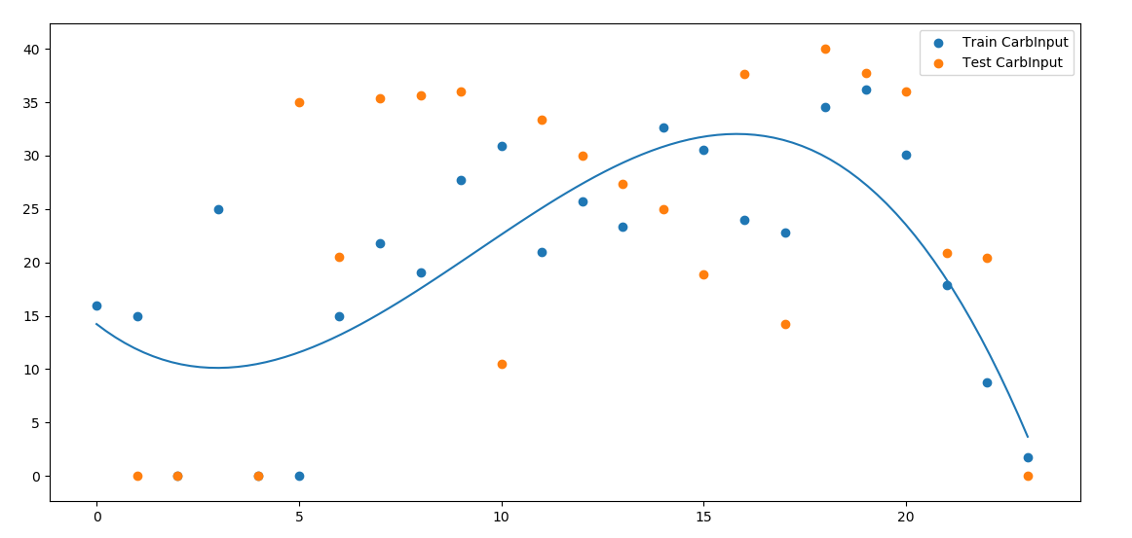
Business Problem 2
Model, Results and Evaluation
Fitted Distribution for Meal timing and Size : Polynomial (order =3)
Average Meal size : Carb Input
Polynomial (order =3)
Time : 24 hours at 15 mins interval
Model Evaluation Metric : R2
R2 Test: 0.23
R2 Train : 0.60

Slide 10
Next Steps and Improvements
Build model on a rolling window both training and prediction
Apply other types of algorithms including deep-learning and compare their performances to SARIMAX
Further exploratory analysis with multiple samples.
Problem 1
Time Step 1 : Training window
Forecasting
Time Step 2 : Training window
Forecasting
Time Step 3 : Training window
Forecasting
All combinations of SiteID, PtID, ParentHDeviceUploadsID can be used for developing more robust distribution function.
These combinations can be split into two groups – one for creating the function and other as virtual subjects for control and evaluation.
Problem 2
All Combinations from
entire population
=
Selected Combinations for function
+
Virtual Subjects
PRESENT
FUTURE
Time Step : Training window
Forecasting
HISTORICAL

Slide 11
Thank You

